Slide 1
PROJECT STRONGBOX
Capitalizing on Security, Performance, and Energy Tradeoffs in Full Drive/Disk Encryption Schemes for Fun and Profit
BERNARD DICKENS III HARYADI S. GUNAWI DAVID CASH ARIEL J. FELDMAN HENRY HOFFMANN
Notes:
Go slow—speak slowly!
Good morning everyone and thanks for coming. My name is Bernard Dickens.
I’m presenting for my candidacy exam our work on the StrongBox project, which has the goal of ->
capitalizing on security, performance, and energy tradeoffs in Full Drive Encryption schemes.
<PRESS SPACE>

Slide 2
STRONGBOX
StrongBox I (Published in ASPLOS 2018)
We overturn the conventional wisdom regarding FDE: stream ciphers are suitable for FDE!
We develop and implement a secure approach to FDE based on the ChaCha20 stream cipher, F2FS LFS, and RPMB eMMC trusted hardware
StrongBox II (April 2019)
We consider the tradeoff space and motivated use cases formed between ciphers other than just ChaCha20 (e.g. Freestyle, Rabbit, AES-CTR)
StrongBox III (Q4 2019)
We present a novel theoretical framework for FDE and formally evaluate the security guarantees of our (and other) constructions
Notes:
The project consists of three principal components we call StrongBox 1 through StrongBox 3.
<PRESS SPACE>

Slide 3
STRONGBOX
StrongBox I (Published in ASPLOS 2018)
We overturn the conventional wisdom regarding FDE: stream ciphers are suitable for FDE!
We develop and implement a secure approach to FDE based on the ChaCha20 stream cipher, F2FS LFS, and RPMB eMMC trusted hardware
Notes:
With StrongBox 1, we focused on the security-performance tradeoff between block ciphers and stream ciphers in the context of FDE.
Specifically: we demonstrated that the conventional wisdom regarding FDE is no longer valid.
In fact, our StrongBox 1 implementation using the ChaCha20 stream cipher provides confidentiality and integrity guarantees ->
equal to or greater than those provided by the state of the art.
<PRESS SPACE>

Slide 4
STRONGBOX
StrongBox I (Published in ASPLOS 2018)
We overturn the conventional wisdom regarding FDE: stream ciphers are suitable for FDE!
We develop and implement a secure approach to FDE based on the ChaCha20 stream cipher, F2FS LFS, and RPMB eMMC trusted hardware
StrongBox II (April 2019)
Building on the success of the StrongBox approach, we consider the wider tradeoff space between ciphers beyond ChaCha20 and the use cases they motivate
Notes:
Having demonstrated the efficacy of the StrongBox approach to Full Drive Encryption, we turn our attention to ciphers beyond the 20-round ChaCha and AES of StrongBox 1.
It turns out that there are many stream ciphers in existence, and they each exhibit different characteristics under StrongBox. For example: some ciphers offer stronger security guarantees in exchange for less throughput while others focus on being energy-efficient when implemented in software.
Our goal with the second leg of the project is to exploit this “cipher configuration space” by dynamically trading off various security properties, system performance, and system energy use (among other concerns).
<PRESS SPACE>

Slide 5
STRONGBOX
StrongBox I (Published in ASPLOS 2018)
We overturn the conventional wisdom regarding FDE: stream ciphers are suitable for FDE!
We develop and implement a secure approach to FDE based on the ChaCha20 stream cipher, F2FS LFS, and RPMB eMMC trusted hardware
StrongBox II (April 2019)
Building on the success of the StrongBox approach, we consider the wider tradeoff space between ciphers beyond ChaCha20 and the use cases they motivate
StrongBox III (Q4 2019)
We present a new theoretical framework for FDE, define the cryptographic goals of StrongBox, and formally evaluate the security properties of our construction with respect to these goals
Notes:
And finally, with StrongBox 3, we seek to define a clear set of cryptographic goals StrongBox should achieve ->
and to introduce a theoretical framework to formally model and rigorously evaluate StrongBox’s security properties with respect to these goals.
But <PRESS SPACE> let’s start at the beginning with the original StrongBox approach.
Remember: aim for around FOURTY MINUTES!

Slide 6
STRONGBOX
StrongBox I (Published in ASPLOS 2018)
We overturn the conventional wisdom regarding FDE: stream ciphers are suitable for FDE!
We develop and implement a secure approach to FDE based on the ChaCha20 stream cipher, F2FS LFS, and RPMB eMMC trusted hardware
StrongBox II (April 2019)
Building on the success of the StrongBox approach, we consider the wider tradeoff space between ciphers beyond ChaCha20 and the use cases they motivate
StrongBox III (Q4 2019)
We present a new theoretical framework for FDE, define the cryptographic goals of StrongBox, and formally evaluate the security properties of our construction with respect to these goals
Notes:
And finally, with StrongBox 3, we seek to define a clear set of cryptographic goals StrongBox should achieve ->
and to introduce a theoretical framework to formally model and rigorously evaluate StrongBox’s security properties with respect to these goals.
But <PRESS SPACE> let’s start at the beginning with the original StrongBox approach.
<PRESS SPACE AGAIN>
Remember: aim for around FOURTY MINUTES!

Slide 7
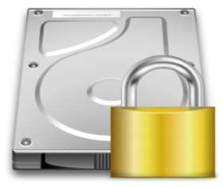
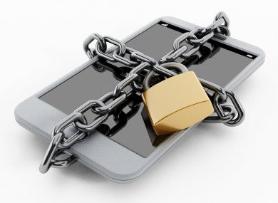

FULL DRIVE (DISK) ENCRYPTION?
STRONGBOX I
Notes:
These days, most are familiar with the concept of Full Drive (or Full Disk) Encryption: it’s the process of securing data at rest
Be it the data on your: Hard drive, or flash drive, or SSD, or on your smart phone or mobile device
Now, the industry standard in full drive encryption is <PRESS SPACE>

Slide 8
FULL DRIVE (DISK) ENCRYPTION?
Industry standard for FDE: AES-XTS
STRONGBOX I
Notes:
AES in XTS mode or AES-XTS, which is implemented in software from Microsoft’s Bitlocker all the way to Apple’s FileVault and Linux’s dm-crypt.
So AES-XTS is necessarily the state of the art <PRESS SPACE>

Slide 9
AES BLOCK CIPHER IN XTS MODE
AES is a block cipher
STRONGBOX I
Notes:
Now: AES-XTS is a block cipher <PRESS SPACE> originally conceived with spinning disks in mind <PRESS SPACE>

Slide 10

AES BLOCK CIPHER IN XTS MODE
AES is a block cipher
Inspired by traditional spinning disk storage
STRONGBOX I
Notes:
Now: AES-XTS is a block cipher <PRESS SPACE> originally conceived with spinning disks in mind
<PRESS SPACE>

Slide 11
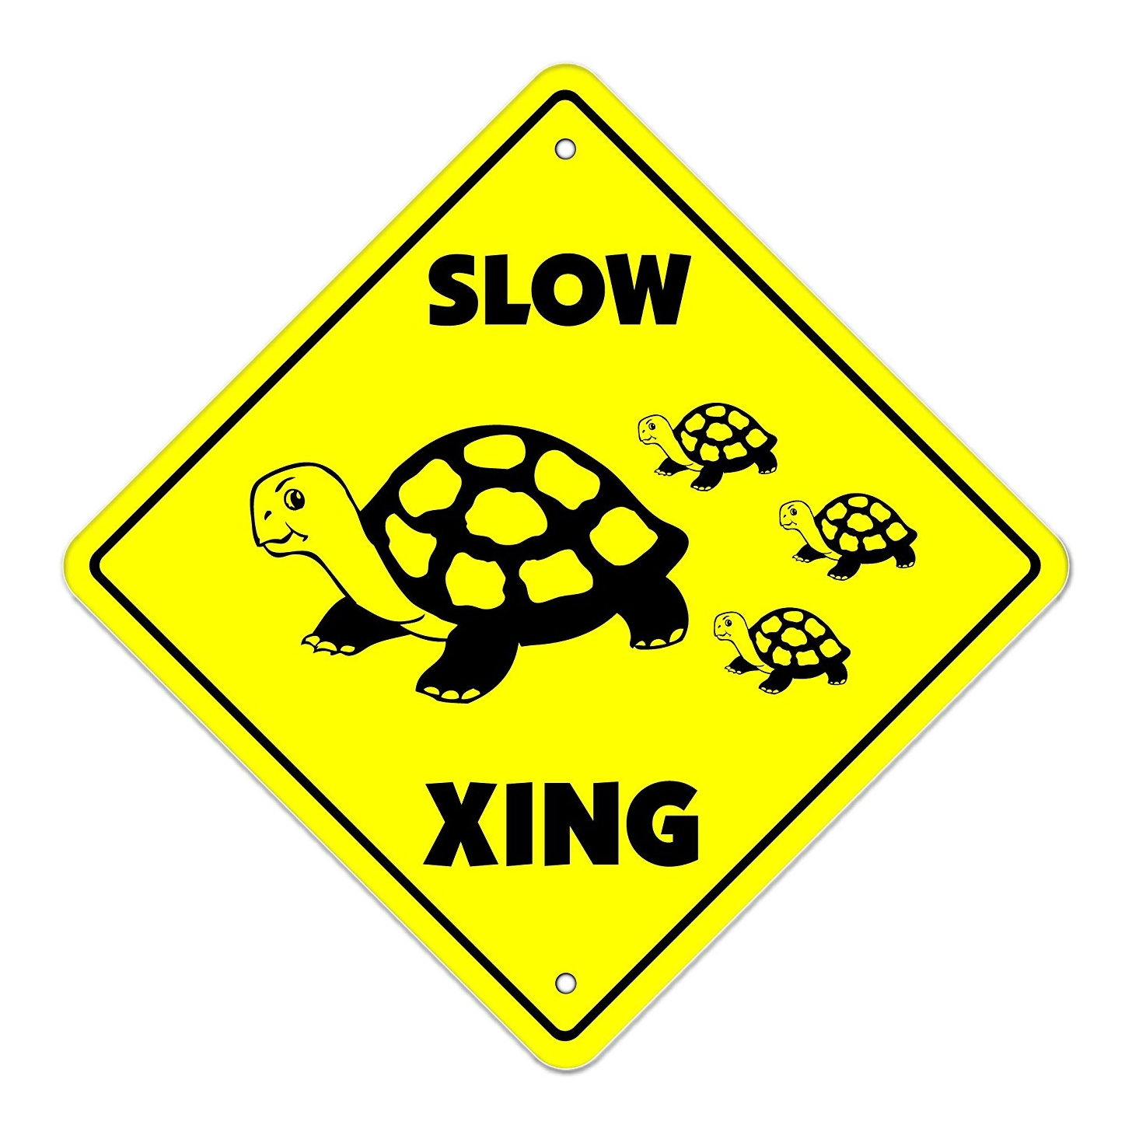
AES BLOCK CIPHER IN XTS MODE
AES is a block cipher
Inspired by traditional spinning disk storage
Problem: AES-XTS is SLOW
DATA
AES-XTS
DATA
DATA
STRONGBOX I
Notes:
Unfortunately, AES-XTS is very slow. Compared to unencrypted storage, AES-XTS can slowdown I/O anywhere from 3-5x
This is partly because the AES cipher is known to be slow, but it’s also due to how AES functions in XTS mode
<PRESS SPACE>

Slide 12
AES BLOCK CIPHER IN XTS MODE
AES is a block cipher
Inspired by traditional spinning disk storage
Problem: AES-XTS is SLOW
Cause: narrow AES “blocks,” wide disk sectors
DISK SECTOR
STRONGBOX I
Notes:
When crypting your disk, AES-XTS works sector by sector.
Take any arbitrary disk sector. AES-XTS will divide that sector into blocks and, using some initialization vector, will encrypt the first block
<PRESS SPACE>

Slide 13
AES BLOCK CIPHER IN XTS MODE
AES is a block cipher
Inspired by traditional spinning disk storage
Problem: AES-XTS is SLOW
Cause: narrow AES “blocks,” wide disk sectors
DISK SECTOR
STRONGBOX I
Notes:
Once complete, it will use the output from that previous operation to encrypt the next block <PRESS SPACE>

Slide 14
AES BLOCK CIPHER IN XTS MODE
AES is a block cipher
Inspired by traditional spinning disk storage
Problem: AES-XTS is SLOW
Cause: narrow AES “blocks,” wide disk sectors
DISK SECTOR
STRONGBOX I
Notes:
And repeats the process for the next block. <PRESS SPACE>

Slide 15
AES BLOCK CIPHER IN XTS MODE
AES is a block cipher
Inspired by traditional spinning disk storage
Problem: AES-XTS is SLOW
Cause: narrow AES “blocks,” wide disk sectors
DISK SECTOR
STRONGBOX I
Notes:
And the next block <PRESS SPACE>

Slide 16
AES BLOCK CIPHER IN XTS MODE
AES is a block cipher
Inspired by traditional spinning disk storage
Problem: AES-XTS is SLOW
Cause: narrow AES “blocks,” wide disk sectors
DISK SECTOR
STRONGBOX I
Notes:
And so on <PRESS SPACE> until the entire sector is crypted.

Slide 17
AES BLOCK CIPHER IN XTS MODE
AES is a block cipher
Inspired by traditional spinning disk storage
Problem: AES-XTS is SLOW
Cause: narrow AES “blocks,” wide disk sectors
DISK SECTOR
FINALLY DONE!
STRONGBOX I
Notes:
And so on <PRESS SPACE> until the entire sector is crypted.
Again, this is a relatively slow process.
Can we do better?
<PRESS SPACE>

Slide 18
BLOCKS VERSUS STREAMS
Stream ciphers are also a thing
STRONGBOX I
Notes:
The AES-XTS block cipher is the industry standard, but it’s not the only way to do FDE
There are also stream ciphers! (check the time)
<PRESS SPACE>

Slide 19
BLOCKS VERSUS STREAMS
Stream ciphers are also a thing
Data encrypted via XOR as a continuous stream
Your Data:
1
1
1
0
0
1
0
0
⊕
Keystream:
0
1
0
0
1
1
0
1
=
Encrypted:
STRONGBOX I
Notes:
Stream ciphers work by interpreting your data as a series of bits or a “stream” and XORing that data stream with a stream of key bits or the “keystream,” hence the name
<PRESS SPACE>

Slide 20
BLOCKS VERSUS STREAMS
Stream ciphers are also a thing
Data encrypted via XOR as a continuous stream
Stream ciphers are FAST
Cause: XOR (ARX) operation is simple, fast
Your Data:
1
1
1
0
0
1
0
0
⊕
Keystream:
0
1
0
0
1
1
0
1
=
Encrypted:
STRONGBOX I
Notes:
Thanks to their simplicity, stream ciphers are known to be blazing fast and dead simple to implement
<PRESS SPACE>

Slide 21
NOT THE ONLY CIPHER IN TOWN
There are many stream ciphers with various characteristics
STRONGBOX I
Notes:
With StrongBox 1, we focus specifically on the ChaCha20 stream cipher, but there are ->
many stream ciphers and many ciphers that exhibit various characteristics under StrongBox.
<PRESS SPACE>

Slide 22
NOT THE ONLY CIPHER IN TOWN
There are many stream ciphers with various characteristics
High throughput ciphers
Sosemanuk and Rabbit
STRONGBOX I
Notes:
For example, there are ciphers constructed to be high throughput <PRESS SPACE>
And there are ciphers built to be energy efficient or high performance when implemented in software <PRESS SPACE>
And there are ciphers that can operate non-deterministically and naturally resist cryptanalysis <PRESS SPACE>
And there are many others with interesting characteristics <PRESS SPACE>

Slide 23
NOT THE ONLY CIPHER IN TOWN
There are many stream ciphers with various characteristics
High throughput ciphers
Sosemanuk and Rabbit
Software/energy efficient ciphers
ChaCha and Salsa
STRONGBOX I
Notes:
For example, there are ciphers constructed to be high throughput <PRESS SPACE>
And there are ciphers built to be energy efficient or high performance when implemented in software <PRESS SPACE>
And there are ciphers that can operate non-deterministically and naturally resist cryptanalysis <PRESS SPACE>
And there are many others with interesting characteristics <PRESS SPACE>

Slide 24
NOT THE ONLY CIPHER IN TOWN
There are many stream ciphers with various characteristics
High throughput ciphers
Sosemanuk and Rabbit
Software/energy efficient ciphers
ChaCha and Salsa
Tweakable overwrite-resistant ciphers
Freestyle
STRONGBOX I
Notes:
For example, there are ciphers constructed to be high throughput <PRESS SPACE>
And there are ciphers built to be energy efficient or high performance when implemented in software <PRESS SPACE>
And there are ciphers that can operate non-deterministically and naturally resist cryptanalysis <PRESS SPACE>
And there are many others with interesting characteristics <PRESS SPACE>

Slide 25
NOT THE ONLY CIPHER IN TOWN
There are many stream ciphers with various characteristics
High throughput ciphers
Sosemanuk and Rabbit
Software/energy efficient ciphers
ChaCha and Salsa
Tweakable overwrite-resistant ciphers
Freestyle
Hardware-accelerated and other interesting ciphers
Reduced-round ChaCha (e.g. ARM Neon impl)
CTR mode block ciphers (e.g. AES-CTR)
STRONGBOX I
Notes:
For example, there are ciphers constructed to be high throughput <PRESS SPACE>
And there are ciphers built to be energy efficient or high performance when implemented in software <PRESS SPACE>
And there are ciphers that can operate non-deterministically and naturally resist cryptanalysis <PRESS SPACE>
And there are many others with interesting characteristics <PRESS SPACE>

Slide 26

Switch Ciphers, Problem Solved?
STRONGBOX I
Notes:
So… easy, right? We can just switch out the slower block cipher for the faster stream cipher and call it a day.
Well…
<PRESS SPACE>

Slide 27
Big Problems with Stream Ciphers
There are two big problems with using stream ciphers for FDE:
STRONGBOX I
Notes:
There are 2 major issues that prevent us from considering a stream cipher for FDE: <PRESS SPACE>

Slide 28
Big Problems with Stream Ciphers
There are two big problems with using stream ciphers for FDE:
Data confidentiality can be trivially violated with overwrites
STRONGBOX I
Notes:
The first is that, when using a stream cipher naively, two or more writes to the same location in storage will trivially and utterly break your encryption and reveal your data to an attacker
<PRESS SPACE>

Slide 29
Big Problems with Stream Ciphers
There are two big problems with using stream ciphers for FDE:
Data confidentiality can be trivially violated with overwrites
Rolling back the system to a previously valid state also leads to confidentiality violations
STRONGBOX I
Notes:
The second is, if the system is rolled back to a previously valid state, an adversary could trick the system into breaking your encryption by comparing states
<PRESS SPACE>

Slide 30
Overwrites Are a Big Deal
Why are overwrites such a problem?
Overwrites violate confidentiality
Rollbacks lead to overwrites
Notes:
Now: As to the first problem, why does a simple overwrite break your encryption and breach confidentiality when using a stream cipher?
Well…
<PRESS SPACE>

Slide 31


Overwrites Are a Big Deal
Why are overwrites such a problem?
Your Data:
Keystream:
Overwrites violate confidentiality
Rollbacks lead to overwrites
Notes:
Let’s say you have the data you’re trying to encrypt and you have your keystream. <PRESS SPACE>

Slide 32


Overwrites Are a Big Deal
Why are overwrites such a problem?
Your Data:
⊕ =>
Keystream:
Encrypted
Overwrites violate confidentiality
Rollbacks lead to overwrites
Notes:
To encrypt your data, you XOR it with the keystream and the output would be encrypted bytes
<PRESS SPACE>

Slide 33

Overwrites Are a Big Deal
Why are overwrites such a problem?
Your Data:
(the same)
Keystream:
Overwrites violate confidentiality
Rollbacks lead to overwrites
Notes:
Now: say you were to encrypt more data with that same keystream. <PRESS SPACE>

Slide 34


Overwrites Are a Big Deal
Why are overwrites such a problem?
Your Data:
⊕ =>
(the same)
Encrypted?
Keystream:
Overwrites violate confidentiality
Rollbacks lead to overwrites
Notes:
You also get an output that looks indistinguishable from random and so we may call it encrypted. But… <PRESS SPACE>

Slide 35
Overwrites Are a Big Deal
Why are overwrites such a problem?
Original Write:
d’ ⊕ pad = c’
(i.e. same keystream)
Overwrite:
Overwrites violate confidentiality
Rollbacks lead to overwrites
Notes:
If you take the outputs from both encryption operations and XOR them <PRESS SPACE>

Slide 36


Overwrites Are a Big Deal
Why are overwrites such a problem?
Original Write:
d’ ⊕ pad = c’
⊕ =>
(i.e. same keystream)
ENCRYPTION BROKEN!
Overwrite:
Overwrites violate confidentiality
Rollbacks lead to overwrites
Notes:
You can trivially factor out the keystream and very easily reveal the data you wanted to keep secret.
That’s a violation of confidentiality. Your encryption is broken.
<PRESS SPACE>

Slide 37
Overwrites Are a Big Deal
Why are overwrites such a problem?
The solution: “rekey” the keystream on every overwrite
Overwrites violate confidentiality
Rollbacks lead to overwrites
Notes:
The solution, of course, would be to use a different keystream or “rekey” the stream cipher every time you want to encrypt data <PRESS SPACE>

Slide 38
Overwrites Are a Big Deal
Why are overwrites such a problem?
The solution: “rekey” the keystream on every overwrite
Another problem: rekeying is expensive!
Overwrites violate confidentiality
Rollbacks lead to overwrites
Notes:
Unfortunately, when using a stream cipher for FDE, this “rekeying” process becomes quite expensive
<PRESS SPACE>

Slide 39
Overwrites Are a Big Deal
Why are overwrites such a problem?
The solution: “rekey” the keystream on every overwrite
Another problem: rekeying is expensive!
Out of ~17,000 write ops, EXT4 makes ~10,000 overwrites
10,000 x expensive operation = performance degradation
This expense negates perf benefit of the stream cipher
Overwrites violate confidentiality
Rollbacks lead to overwrites
Notes:
Take, for example, the popular EXT4 file system
We observe that, when writing and then deleting a relatively small 250MB file three times, more than half of the write operations Ext4 makes are actually overwrites to locations it had written to previously.
Slow down!
You can imagine, then, that, were we to trigger an expensive rekeying operation after every write operation that constituted an overwrite, we would observe a massive degradation in the performance of our filesystem.
And we do!
<PRESS SPACE>

Slide 40

ROLLBACKs Are Compromising
Rollbacks are even worse!
Overwrites violate confidentiality
Rollbacks lead to overwrites
Notes:
Now: The second problem is that of an adversary taking snapshots <PRESS SPACE> of the system at some valid states and then later <PRESS SPACE> rolling the system back to the earliest previously valid states.
<PRESS SPACE>

Slide 41
ROLLBACKs Are Compromising
Rollbacks are even worse!
Take a snapshot of the system at valid state
Overwrites violate confidentiality
Rollbacks lead to overwrites
Notes:
Now: The second problem is that of an adversary taking snapshots <PRESS SPACE> of the system at some valid states and then later <PRESS SPACE> rolling the system back to the earliest previously valid states.
<PRESS SPACE>

Slide 42
ROLLBACKs Are Compromising
Rollbacks are even worse!
Take a snapshot of the system at valid state
Rollback the system to a previous valid state
Overwrites violate confidentiality
Rollbacks lead to overwrites
Notes:
Now: The second problem is that of an adversary taking snapshots <PRESS SPACE> of the system at some valid states and then later <PRESS SPACE> rolling the system back to the earliest previously valid states.
<PRESS SPACE>

Slide 43
ROLLBACKs Are Compromising
Rollbacks are even worse!
Take a snapshot of the system at valid state
Rollback the system to a previous valid state
Allow writes as normal
Overwrites violate confidentiality
Rollbacks lead to overwrites
Notes:
If the rollback went unnoticed and writes were allowed to continue as normal
<PRESS SPACE>

Slide 44
ROLLBACKs Are Compromising
Rollbacks are even worse!
Take a snapshot of the system at valid state
Rollback the system to a previous valid state
Allow writes as normal
Contrast (XOR) encrypted snapshot with current “encrypted” state
SAME AS AN OVERWRITE!
Overwrites violate confidentiality
Rollbacks lead to overwrites
Notes:
An adversary could contrast the currently valid encrypted system with their most recent valid snapshot and force a compromising overwrite condition without the system having actually made any overwrite!
<PRESS SPACE>

Slide 45

No!
You can only use
a block cipher for
Full Drive
Encryption!
Notes:
And it is for these reasons that stream ciphers are assumed to be unsuitable for FDE… <PRESS SPACE> … leaving AES-XTS as our fastest viable option and, therefore, the industry standard.
At least, that was the assumption.
<PRESS SPACE>
Check the time and perhaps slow down a bit… and GO! You’re doing great ☺

Slide 46
The Old Assumption
Stream ciphers are faster…
… but the overhead of dealing with overwrites and rollbacks negates any potential perf benefit
Hence, AES-XTS is the industry standard
STRONGBOX I
Notes:
And it is for these reasons that stream ciphers are assumed to be unsuitable for FDE… <PRESS SPACE> … leaving AES-XTS as our fastest viable option and, therefore, the industry standard.
At least, that was the assumption.
<PRESS SPACE>
Check the time and perhaps slow down a bit… and GO! You’re doing great ☺

Slide 47
the Old Assumption: Invalidated
Key insight: two technology trends invalidate old assumption
STRONGBOX I
Notes:
However: we argue that two recent trends in technology invalidate the premises of this old assumption.
Specifically:
<PRESS SPACE>

Slide 48
the Old Assumption: Invalidated
Key insight: two technology trends invalidate old assumption
Non-volatile flash memory as secondary storage
Governed by Flash Translation Layer (FTL)
FTL tends to avoid overwriting same cells (wear-leveling)
STRONGBOX I
Notes:
The widespread adoption of NV flash based storage, most of which is governed by some form of Flash Translation Layer or “FTL”.
The key property of these FTLs we’ll be exploiting is their tendency to spread writes out across the physical device and avoid overwriting the same cell.
<PRESS SPACE>

Slide 49
the Old Assumption: Invalidated
Key insight: two technology trends invalidate old assumption
Non-volatile flash memory as secondary storage
Governed by Flash Translation Layer (FTL)
FTL tends to avoid overwriting same cells (wear-leveling)
Proliferation of secure hardware
TPM/TEE implemented by nearly all computer and mobile device manufacturers
Secure hardware allows us to actively version system state and detect rollbacks
STRONGBOX I
Notes:
Further:
We observe the proliferation of secure hardware, such as trusted platform modules and trusted execution environments, which are featured in nearly all computer and personal mobile devices manufactured today. We can leverage this secure hardware to track system state and detect any rollbacks.
<PRESS SPACE>

Slide 50
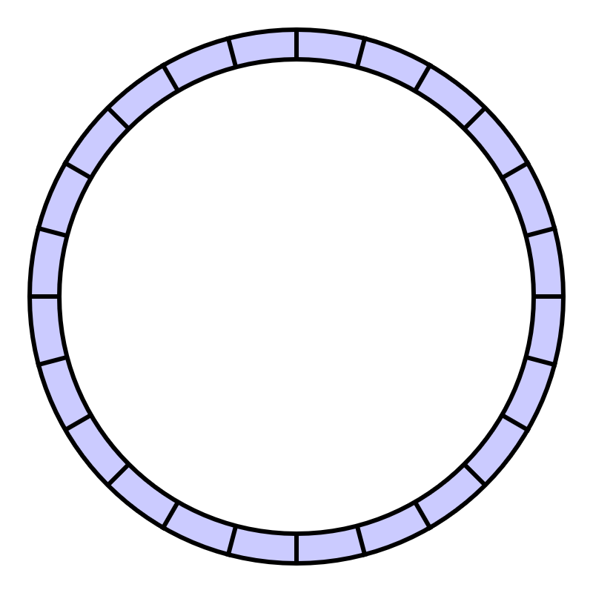
FTL <=> LFS
FTL operates like a Log-structured File System (LFS)
FTL = LFS = append-only writes
(naturally avoids overwrites)
STRONGBOX I
Notes:
Now: the filesystem counterpart of FTL is the log-structured filesystem or LFS.
An LFS is an append-only FS, makes as few overwrites as possible, and operates like a ring buffer where all write operations are appended to the end of the “log,” hence the name.
Again: FTLs and LFSes are designed to make as few overwrites as possible.
<PRESS SPACE>

Slide 51
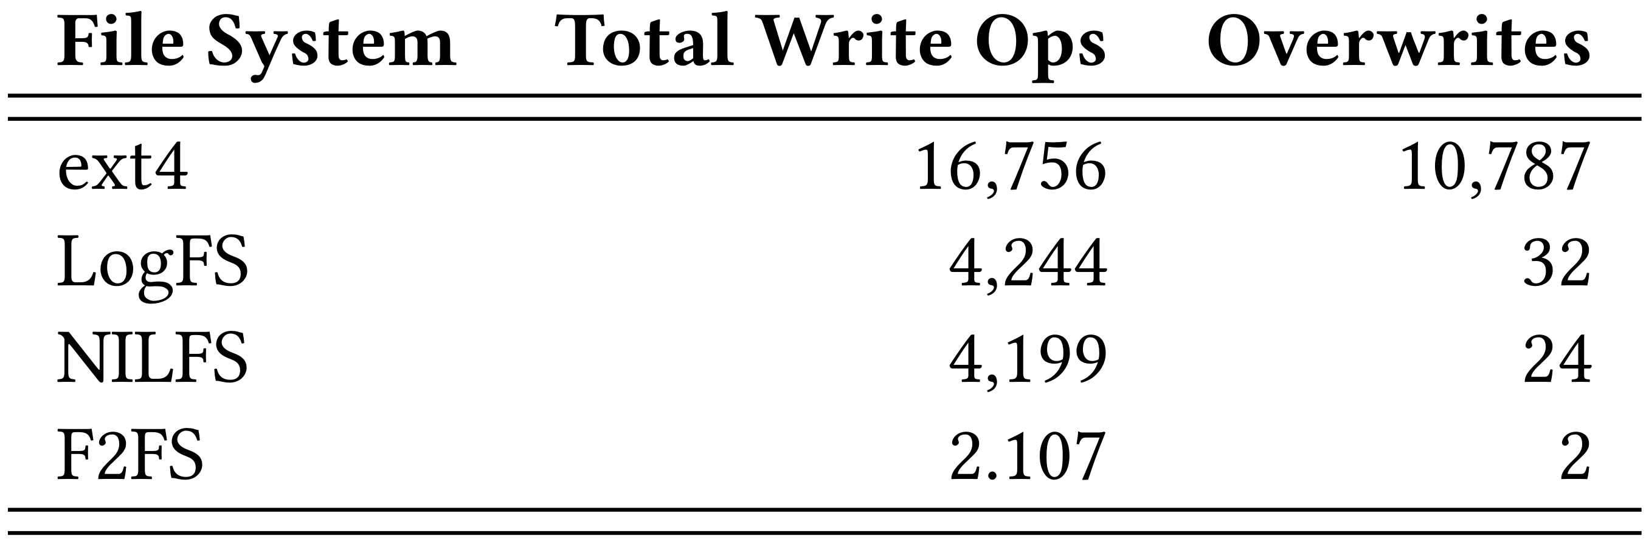
LFS Makes Few Overwrites
STRONGBOX I
Notes:
In fact, we observe that, when writing and then deleting a relatively small 250MB file three times, the LFSes make very few overwrites when compared to the non-LFS Ext4 file system. In the case of F2FS, only 2 overwrites occur.
<PRESS SPACE>

Slide 52

Actively Versioning System State
TPM/TEE allows us to actively version system state
STRONGBOX I
Notes:
Further: we can leverage secure hardware to actively version the system state and detect rollbacks.
<PRESS SPACE>

Slide 53
Actively Versioning System State
TPM/TEE allows us to actively version system state
Accomplished with fast secure monotonic counters
STRONGBOX I
Notes:
This is accomplished with the use of a secure monotonic counter, which can be implemented using any TPM or TEE secure hardware widely available today <PRESS SPACE>

Slide 54
Actively Versioning System State
TPM/TEE allows us to actively version system state
Accomplished with fast secure monotonic counters
These hardware counters cannot be rolled back!
STRONGBOX I
Notes:
These secure counters are immune to being rolled back without an extensive and very conspicuous physical attack on said hardware.
Like: we’re talking sawdering (soldering) iron, hammer, motherboard.
<PRESS SPACE>

Slide 55

The Grand Solution
Leveraging the trends, we proposed StrongBox
A drop-in replacement for AES-backed FDE providers such as dm-crypt
Uses a stream cipher instead of the AES-XTS block cipher
Uses an LFS to avoid overwrites and rekeying penalties
Uses secure monotonic counters to prevent rollbacks
STRONGBOX I
Notes:
Bringing it all together, we propose the original StrongBox ->
A drop in replacement for dm-crypt and other FDE providers.
StrongBox provides confidentiality and integrity guarantees equal to or greater than those provided by AES-XTS based alternatives by leveraging secure hardware and the FTL or a LFS.
<PRESS SPACE>

Slide 56
Threat Model
Confidentiality
dm-crypt (AES-XTS): AES block cipher
StrongBox: ChaCha20 stream cipher
STRONGBOX I
Notes:
Now, in terms of threat model...
Specifically: in addressing the threat to the confidentiality of data at rest…
dm-crypt employs the AES cipher in XTS mode.
With our original implementation of StrongBox, we employ Daniel Bernstein’s excellent ChaCha20 stream cipher instead.
<PRESS SPACE>

Slide 57
Threat Model
Confidentiality
dm-crypt (AES-XTS): AES block cipher
StrongBox: ChaCha20 stream cipher
Overwrites (many-time pad)
dm-crypt (AES-XTS): N/A
StrongBox: append-only write property of FTL/LFS
STRONGBOX I
Notes:
As for the threat posed by many-time pad attacks:
This is outside of the threat model for AES-XTS by design and can be safely ignored.
For StrongBox, we leverage the append-only nature of the LFS or FTL to avoid overwrites and rekey when necessary.
<PRESS SPACE>

Slide 58
Threat Model (continued)
Rollbacks
dm-crypt (AES-XTS): N/A
StrongBox: secure monotonic counters
STRONGBOX I
Notes:
As for the threat posed by rollbacks…
This is also outside of AES-XTS’s threat model and so is ignored.
StrongBox, on the other hand, must handle this by leveraging available secure monotonic counters.
<PRESS SPACE>

Slide 59
Threat Model (continued)
Rollbacks
dm-crypt (AES-XTS): N/A
StrongBox: secure monotonic counters
Integrity
dm-crypt (AES-XTS): hopefully the user is paying attention
StrongBox: hashing scheme to tie system state to counter
STRONGBOX I
Notes:
As for threats to integrity… AES-XTS does not make any explicit integrity guarantees. The XTS mode will probably scramble a sector if it is tampered with, and hopefully someone notices.
With StrongBox, we employ a hashing scheme to tie the entire system state to the monotonic counter such that any illegal variation in system state will be immediately obvious.
<PRESS SPACE>

Slide 60
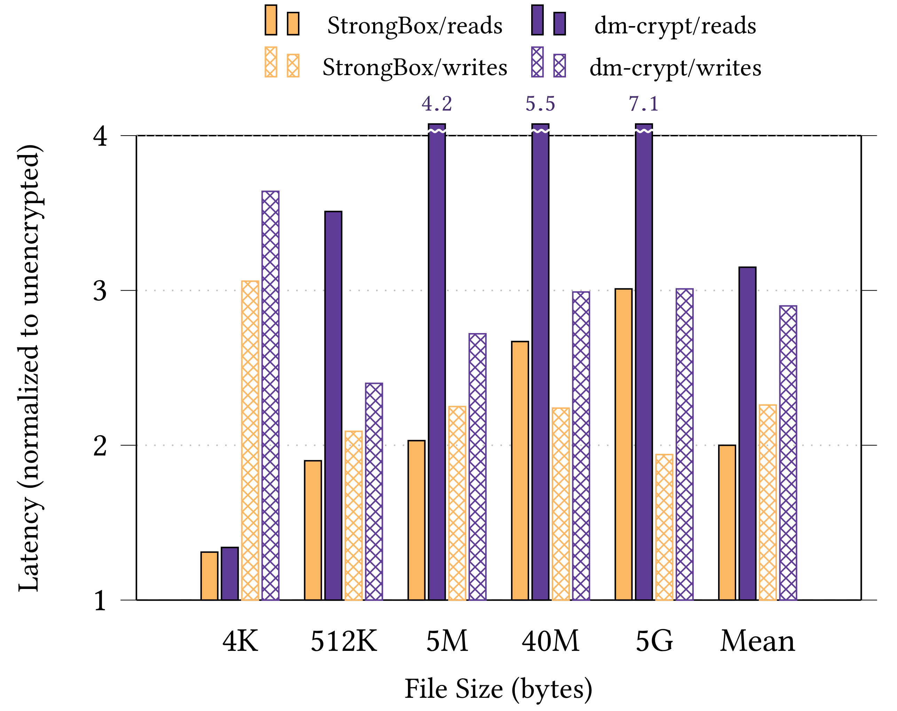
Performance Win
By harmonic mean:
1.7x faster reads
1.3x faster writes
Experimental setup:
Odroid XU3 ARM big.LITTLE system
eMMC 5.0HS400 backing store
STRONGBOX I
Notes:
So we believe we’re more secure, but are we faster? Well:
<say this part slowly>
FOR the F2FS LFS MOUNTED ATOP StrongBox vs ATOP dm-crypt AES-XTS for sequential IO:
We observe StrongBox to be faster than dm-crypt in all cases.
(here, latency is normalized to the performance of unencrypted F2FS)
By harmonic mean:
1.7× improvement over baseline for reads
1.3× improvement over baseline for writes
<PRESS SPACE>

Slide 61
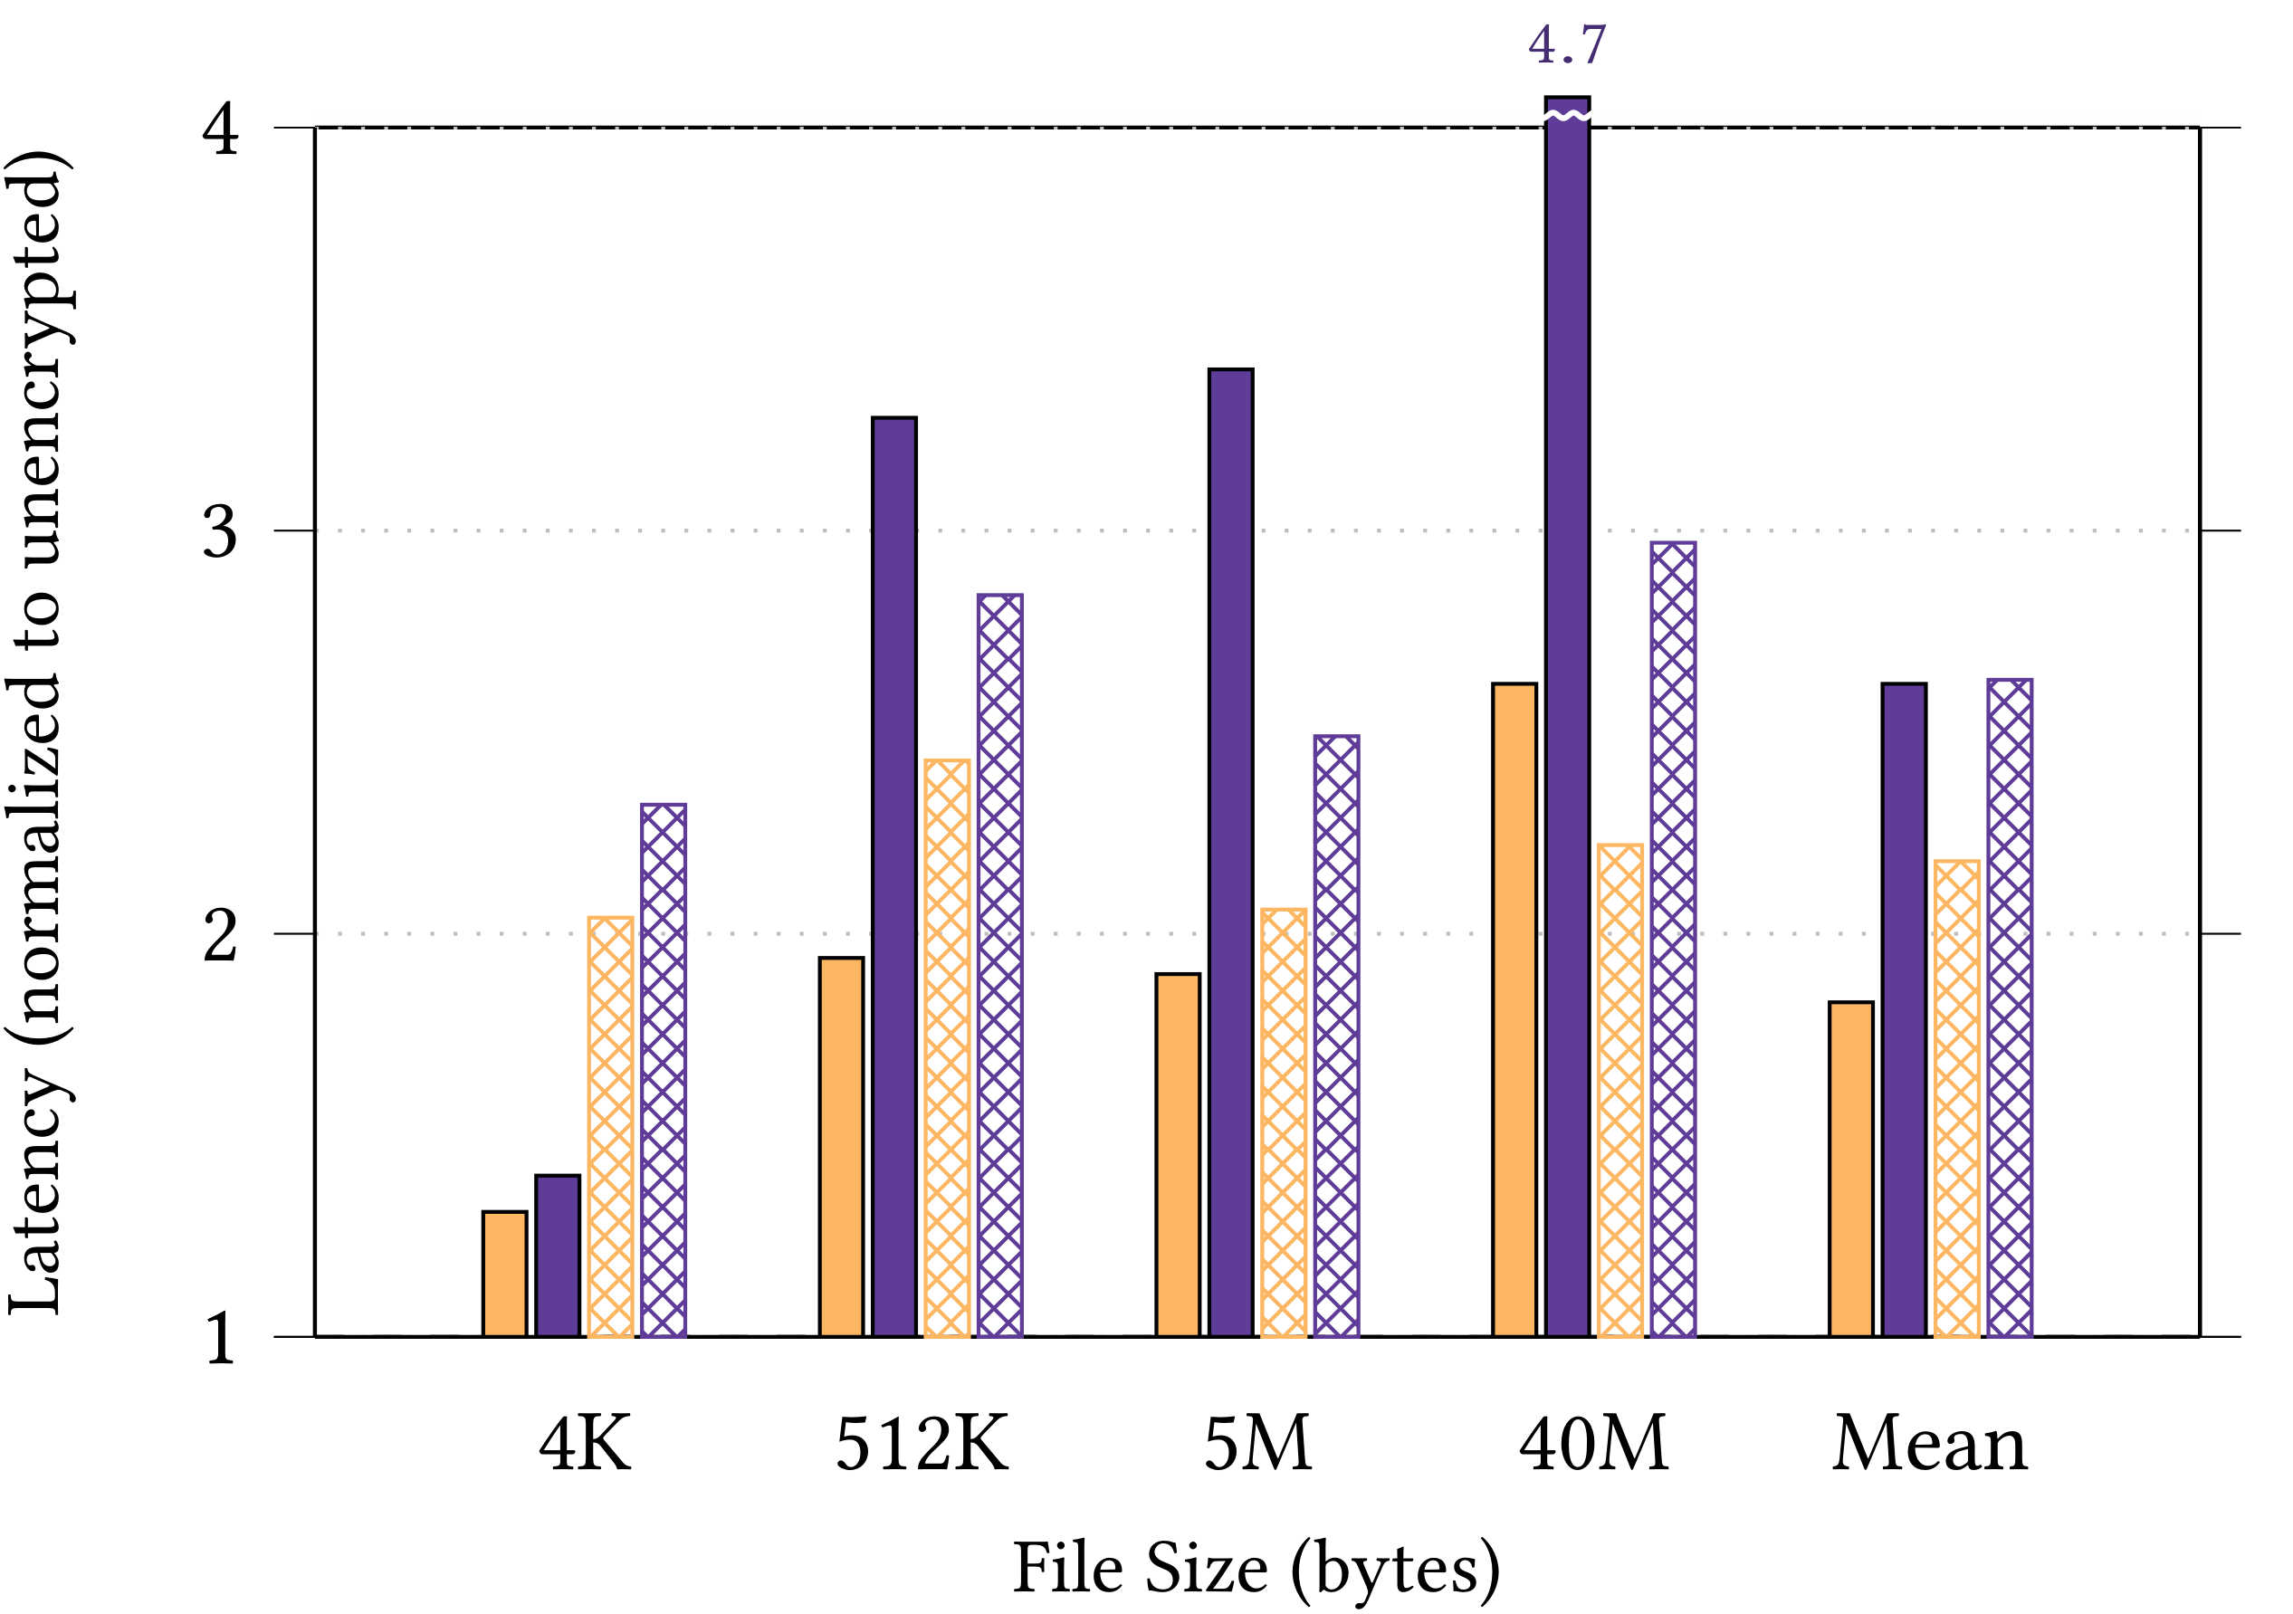
Performance Win (Random IO)
By harmonic mean:
1.7x faster reads
1.3x faster writes
Experimental setup:
Odroid XU3 ARM big.LITTLE system
eMMC 5.0HS400 backing store
STRONGBOX I
Notes:
And we observe similar results for random IO harmonic mean as well.
<PRESS SPACE>

Slide 62
Hardware Accelerated AES?
What about hardware support for AES (i.e. AES-NI?)
STRONGBOX I
Notes:
Sloooow down!
But what about hardware accelerated ciphers? Chacha20 was built to be efficient in software, after all.
<PRESS SPACE>

Slide 63
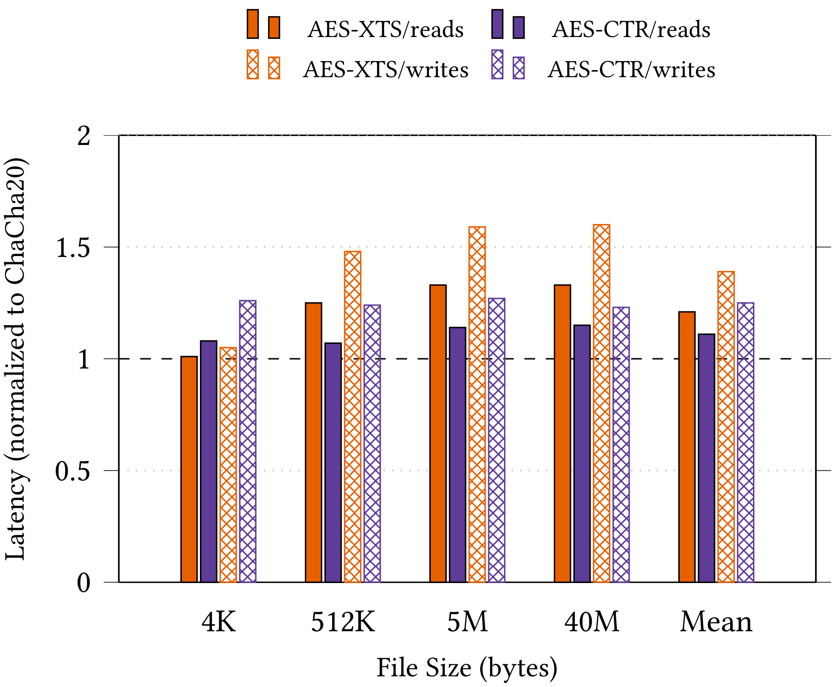
SWITCHING CIPHERS: AES-CTR
STRONGBOX I
Notes:
Well: the XTS mode is not the only mode of operation for the AES block cipher or any block cipher.
There is also counter mode or CTR mode, which allows AES to effectively function as a stream cipher.
We implemented StrongBox with the AES-CTR stream cipher, swapping out ChaCha20, and we observe that AES-CTR is still faster than AES-XTS.
By harmonic mean: AES-CTR is 1.1x faster than AES-XTS for BOTH reads and writes under StrongBox!
<PRESS SPACE>

Slide 64
Using other stream ciphers?
What can we gain with ciphers other than ChaCha20?
Notes:
And that’s interesting. Could we be leaving potential gains on the table here?
Is there utility in switching ciphers, perhaps dynamically, from ChaCha20 to another stream cipher or even a block cipher?
Which leads us to the next phase of this project…
<PRESS SPACE>

Slide 65
STRONGBOX
StrongBox I (Published in ASPLOS 2018)
We overturn the conventional wisdom regarding FDE: stream ciphers are suitable for FDE!
We develop and implement a secure approach to FDE based on the ChaCha20 stream cipher, F2FS LFS, and RPMB eMMC trusted hardware
StrongBox II (April 2019)
Building on the success of the StrongBox approach, we consider the wider tradeoff space between ciphers beyond ChaCha20 and the use cases they motivate
StrongBox III (Q4 2019)
We present a new theoretical framework for FDE, define the cryptographic goals of StrongBox, and formally evaluate the security properties of our construction with respect to these goals
Notes:
<Say it slow>
While StrongBox 1 represents a solved problem, this “cipher switching” insight motivates the next principal component of the StrongBox ->
research or StrongBox 2, where we turn our attention to ciphers beyond 20-round ChaCha and AES.
As stated: there are many stream ciphers in existence, they each behave differently under StrongBox, and we can take advantage of that for fun and profit.
So our goal with StrongBox 2 is to determine how much benefit can be realized from exploiting such a “cipher configuration space” by trading off security properties and guarantees, system performance, and system energy use (among other factors) in response to a dynamic environment with various competing concerns.
<PRESS SPACE>
Remember: check the time. FOURTY MINUTES MAX! Should be @ ~20-25 min mark or a little more

Slide 66

Strongbox Internal Design
DRIVE
(many nuggets)
<= Flake
Fine-grain flakes track overwrites
Coarse-grain nuggets form logical storage units (like blocks) of many flakes
A drive is partitioned into many nuggets
<= Nugget (made of many flakes)
STRONGBOX II
Notes:
Thanks to the methodology behind the StrongBox I design, we are in a great position to enable dynamic offline and even online on-the-fly cipher switching.
Specifically: each drive is partitioned into equal-sized blocks which we call nuggets to avoid confusion with filesystem or disk/drive blocks
These nuggets are further subdivided into an equal number of flakes
This coarse-grain nugget + fine-grain flake construction allows StrongBox 1 to detect and correct for overwrites without hampering performance.
Conveniently, and with a little work, we found it also enables cipher switching at the nugget level.
<PRESS SPACE>

Slide 67
BUILT FOR CIPHER SWITCHING
StrongBox I design methodology (flakes and nuggets) naturally lends itself to switching ciphers both offline and online
STRONGBOX II
Notes:
So: StrongBox is built to abstract away choice of encryption cipher from normal filesystem operation
<PRESS SPACE>

Slide 68
BUILT FOR CIPHER SWITCHING
StrongBox I design methodology (flakes and nuggets) naturally lends itself to switching ciphers both offline and online
Encryption and decryption of nuggets occur independently of one another
STRONGBOX II
Notes:
This is because, like with AES-XTS, encryption and decryption of a nugget’s contents occurs independently of the others.
<PRESS SPACE>

Slide 69
BUILT FOR CIPHER SWITCHING
StrongBox I design methodology (flakes and nuggets) naturally lends itself to switching ciphers both offline and online
Encryption and decryption of nuggets occur independently of one another
We can leverage this compartmentalized approach and a consistent interface to securely crypt different nuggets with any (valid) cipher
STRONGBOX II
Notes:
Hence, we can crypt different nuggets with totally different ciphers, even on the same drive, even under the same filesystem.
<PRESS SPACE>

Slide 70


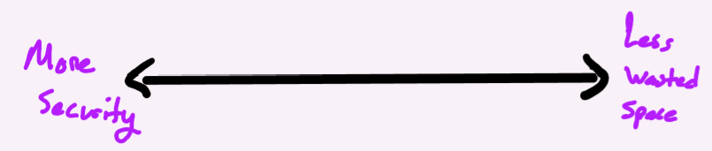
Ciphers BEYOND CHACHA20
Different ciphers behave differently under StrongBox
Various security guarantees offered
Various performance and power profiles for a given workload
Various storage requirements per block beyond StrongBox metadata storage
STRONGBOX II
Notes:
But what motivates us to want to dynamically swap ciphers again?
Well, it’s the vast diversity in cipher behavior observed under StrongBox.
For example: some offer different security guarantees such as output randomization. Others offer various performance and efficiency tradeoffs. Others require extra metadata or storage space.
<PRESS SPACE>

Slide 71
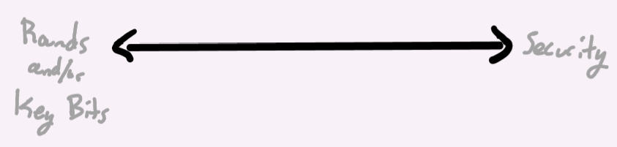
Ciphers BEYOND CHACHA20
Different ciphers behave differently under StrongBox
Various security guarantees offered
Various performance and power profiles for a given workload
Various storage requirements per block beyond StrongBox metadata storage
Some cipher parameters can be explicitly tuned
e.g. rounds, algorithmic complexity, initialization steps
STRONGBOX II
Notes:
On top of that, some ciphers can be tuned so that their security guarantees or performance profile changes depending on the parameters.
<PRESS SPACE>

Slide 72

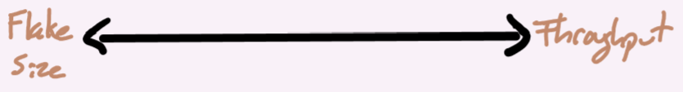
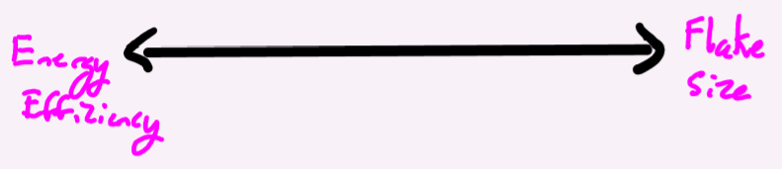
Ciphers BEYOND CHACHA20
Different ciphers behave differently under StrongBox
Various security guarantees offered
Various performance and power profiles for a given workload
Various storage requirements per block beyond StrongBox metadata storage
Some cipher parameters can be explicitly tuned
e.g. rounds, algorithmic complexity, initialization steps
StrongBox itself has tunable parameters (e.g. flake size)
STRONGBOX II
Notes:
On top of that, StrongBox itself has tunable parameters that affect various system metrics depending on workload and other factors.
<PRESS SPACE>

Slide 73

Ciphers BEYOND CHACHA20
Different ciphers behave differently under StrongBox
Various security guarantees offered
Various performance and power profiles for a given workload
Various storage requirements per block beyond StrongBox metadata storage
Some cipher parameters can be explicitly tuned
e.g. rounds, algorithmic complexity, initialization steps
StrongBox itself has tunable parameters (e.g. flake size)
Other choices
STRONGBOX II
Notes:
And the multitude of perceived dimensions off which to trade does not end there.
<PRESS SPACE>

Slide 74
Ciphers BEYOND CHACHA20
Different ciphers behave differently under StrongBox
Various security guarantees offered
Various performance and power profiles for a given workload
Various storage requirements per block beyond StrongBox metadata storage
Some cipher parameters can be explicitly tuned
e.g. rounds, algorithmic complexity, initialization steps
StrongBox itself has tunable parameters (e.g. flake size)
Other choices
Can we leverage this diversity to our benefit? Yes!
STRONGBOX II
Notes:
The main thrust of this research, then, is to leverage this diversity in potential tradeoffs for fun and profit.
<PRESS SPACE>

Slide 75
Motivating Cipher Switching
Dynamically navigating tradeoffs for profit is well-studied
Minimizing energy profiles (POET, CoPPer; Imes et al)
Approximation, self-aware systems (a lot; Hoffmann et al)
Learned models + control theory (CALOREE; Mishra et al)
Complex config optimization (SmartConf; Wang et al)
Many others!
STRONGBOX II
Notes:
In general, profiting from navigating tradeoff spaces, especially in a control-theoretic case, is not a new idea and has received considerable attention by researchers.
And <PRESS SPACE> our research efforts to date have revealed the a worthy space to tradeoff concerns.
<Wait a moment for readers to catch up, then… GO!>
However, we need a “knob” to allow traversal of this space. For this purpose we consider the problem of “quantifying” security.
<PRESS SPACE>

Slide 76
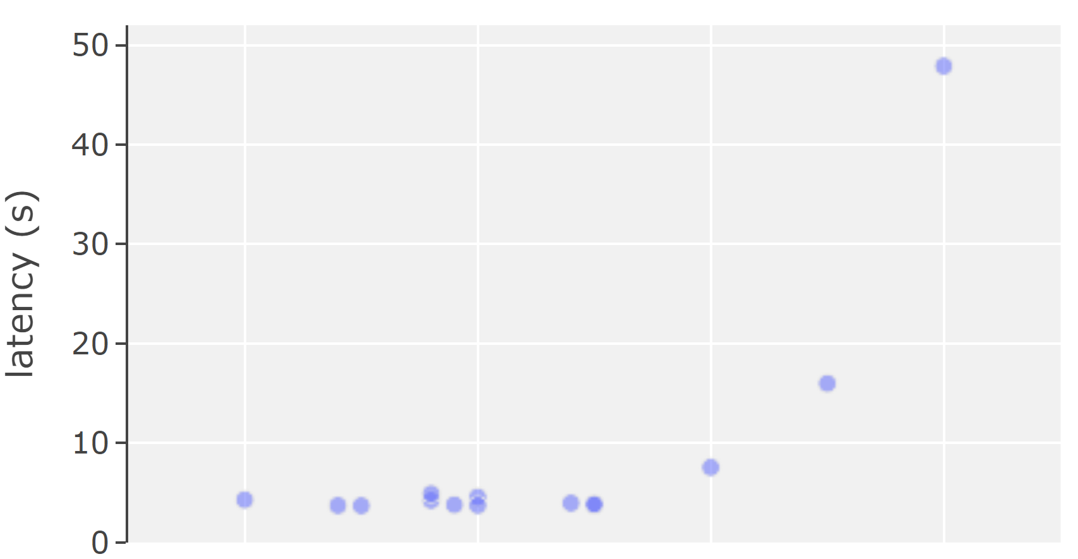
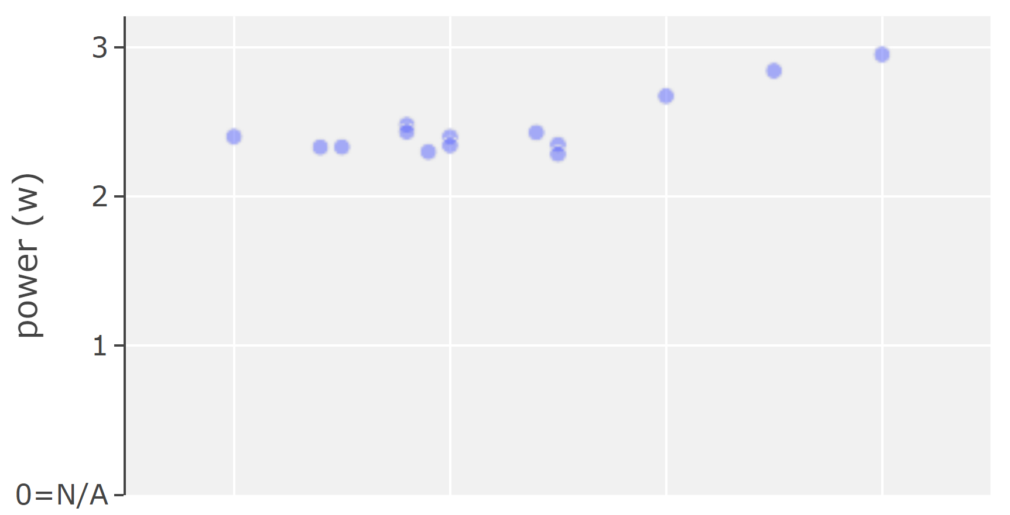
Motivating Cipher Switching (cont.)
Dynamically navigating tradeoffs for profit is well-studied
Comparing ciphers, we observe non-linear relationships between tradeoff dimensions
Tradeoff spaces are here! Need a “knob” to navigate them
Security (quantified)
Security (quantified)
Two examples: security vs latency, power; observed frontier curves for 19 ciphers in various configurations under StrongBox
STRONGBOX II
Notes:
In general, profiting from navigating tradeoff spaces, especially in a control-theoretic fashion, is not a new idea and has received considerable attention by researchers.
And <PRESS SPACE> our research efforts to date have revealed the a worthy space to tradeoff concerns.
<Wait a moment for readers to catch up, then… GO!>
However, we need an independent “knob” to allow traversal of this space. For this purpose we consider the problem of “quantifying” security.
<PRESS SPACE>

Slide 77
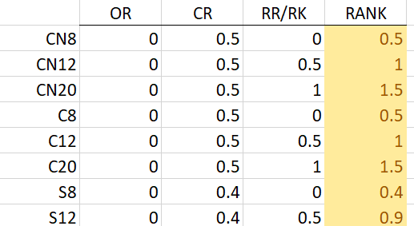
“Quantifying” Security DIMENSION
Quantifying features to determine rank
Output randomization (OR)
Resistance to cryptanalysis (CR)
Relative round/relative key length (RR/RK)
STRONGBOX II
Notes:
Go slow as you explain this slide
There are many ways we might go about quantifying the security guarantees provided by various ciphers. Again: the goal here is to allow a loose “rank” of ciphers from offering more security to less security.
At this point in the research, we’ve arrived at three key features that give us something akin to an ideal distribution:
Output Randomization, which means the cipher can output non-deterministically. Binary feature (0-1). Either it does or it doesn’t.
Resistance to cryptanalysis, which means the cipher can resist theoretical cryptanalytical attacks such as known-plaintext attack and chosen-plaintext attack outside of StrongBox, offline key-guessing attacks, et cetera. Range is from 0 to 1 where 0.5 represents standard generally expected resistance to cryptanalysis for ciphers. Some ciphers, like Freestyle, go far above and beyond this and are ranked higher.
How many “rounds” the cipher executes compared to the accepted “standard” round count for that cipher. For instance, ChaCha8 is a reduced round version of the standardized ChaCha20. Variants are distributed evenly from 0-1. For instance, ChaCha8 gets a 0, ChaCha12 gets a 0.5, and ChaCha20 gets a 1.
<PRESS SPACE>

Slide 78
“Quantifying” Security DIMENSION
Quantifying features to determine rank
Output randomization (OR)
Resistance to cryptanalysis (CR)
Relative round/relative key length (RR/RK)
Ideal: cipher rank distributed evenly along a continuous “security gradient”
Allows us to communicate desired security to the system easily
STRONGBOX II
Notes:
The ideal rank distribution would be a continuous “security gradient”
<PRESS SPACE>

Slide 79
“Quantifying” Security DIMENSION
Quantifying features to determine rank
Output randomization (OR)
Resistance to cryptanalysis (CR)
Relative round/relative key length (RR/RK)
Ideal: cipher rank distributed evenly along a continuous “security gradient”
Allows us to communicate desired security to the system easily
Reality: ciphers ranked non-uniformly and discretely along “security axis” based on the above quantifying features
STRONGBOX II
Notes:
Unfortunately, in reality, the best we can do is a discrete and non-uniform distribution. But for our purposes it is adequate.
<PRESS SPACE>

Slide 80
Characterizing Ciphers
Security (quantified)
Our primary knob!
STRONGBOX II
Notes:
So, to recap, we seek to characterize ciphers by:
- Their security rank <PRESS SPACE>
- How they use system energy <PRESS SPACE>
- Read and write throughput at the filesystem level <PRESS SPACE>
- And other concerns, such as storage area <PRESS SPACE>

Slide 81
Characterizing Ciphers
Security (quantified)
Our primary knob!
Energy use
Strictly linear? Software vs hardware impl tradeoffs?
STRONGBOX II
Notes:
So, to recap, we seek to characterize ciphers by:
- Their security rank <PRESS SPACE>
- How they use system energy <PRESS SPACE>
- Read and write throughput at the filesystem level <PRESS SPACE>
- And other concerns, such as storage area <PRESS SPACE>

Slide 82
Characterizing Ciphers
Security (quantified)
Our primary knob!
Energy use
Strictly linear? Software vs hardware impl tradeoffs?
Performance
Read and write throughput under various StrongBox configurations for sequential and random workloads of varying sizes
STRONGBOX II
Notes:
So, to recap, we seek to characterize ciphers by:
- Their security rank <PRESS SPACE>
- How they use system energy <PRESS SPACE>
- Read and write throughput at the filesystem level <PRESS SPACE>
- And other concerns, such as “wasted” storage area <PRESS SPACE>

Slide 83
Characterizing Ciphers
Security (quantified)
Our primary knob!
Energy use
Strictly linear? Software vs hardware impl tradeoffs?
Performance
Read and write throughput under various StrongBox configurations for sequential and random workloads of varying sizes
Other characteristics
Area (i.e. metadata storage requirements)
STRONGBOX II
Notes:
So, to recap, we seek to characterize ciphers by:
- Their security rank <PRESS SPACE>
- How they use system energy <PRESS SPACE>
- Read and write throughput at the filesystem level <PRESS SPACE>
- And other concerns, such as “wasted” storage area <PRESS SPACE>

Slide 84
Switch Strategies
StrongBox II research (April-May 2019) seeks to answer:
How can StrongBox effectively switch between and utilize different ciphers on the same system?
What does this cipher configuration tradeoff space look like?
Exactly how much benefit is realizable here (use cases)?
STRONGBOX II
Notes:
With our shiny new tradeoff space ready to go, we need some way to translate the potential gains by moving between ciphers into actual benefit. We need a way to physically navigate this space in reality, and determine how much of a benefit we realize.
Again: this is the primary thrust of the StrongBox 2 research.
<PRESS SPACE>

Slide 85
Switch Strategies
StrongBox II research (April-May 2019) seeks to answer:
How can StrongBox effectively switch between and utilize different ciphers on the same system?
What does this cipher configuration tradeoff space look like?
Exactly how much benefit is realizable here (use cases)?
(partial) Answer: cipher switching strategies
STRONGBOX II
Notes:
Our answer is our cipher switching strategies, or certain rulesets that govern how StrongBox transitions nuggets between encrypted states with different ciphers.
<PRESS SPACE>

Slide 86
Switch Strategies
StrongBox II research (April-May 2019) seeks to answer:
How can StrongBox effectively switch between and utilize different ciphers on the same system?
What does this cipher configuration tradeoff space look like?
Exactly how much benefit is realizable here (use cases)?
(partial) Answer: cipher switching strategies
Immediate (slowest total throughput)
STRONGBOX II
Notes:
There is the obvious immediate strategy, where StrongBox tries to wholesale rekey all nuggets at once (which is unacceptably expensive)
<PRESS SPACE>

Slide 87
Switch Strategies
StrongBox II research (April-May 2019) seeks to answer:
How can StrongBox effectively switch between and utilize different ciphers on the same system?
What does this cipher configuration tradeoff space look like?
Exactly how much benefit is realizable here (use cases)?
(partial) Answer: cipher switching strategies
Immediate (slowest total throughput)
Forward Immediate (best for random IO)
STRONGBOX II
Notes:
Then there’s the more reasonable forward immediate strategy, where nuggets are decrypted/rekeyed on the fly.
<PRESS SPACE>

Slide 88
Switch Strategies
StrongBox II research (April-May 2019) seeks to answer:
How can StrongBox effectively switch between and utilize different ciphers on the same system?
What does this cipher configuration tradeoff space look like?
Exactly how much benefit is realizable here (use cases)?
(partial) Answer: cipher switching strategies
Immediate (slowest total throughput)
Forward Immediate (best for random IO)
Aggressive Immediate (sequential IO friendly)
STRONGBOX II
Notes:
There’s the more interesting aggressive immediate strategy, where we attempt to take advantage of spatial locality to rekey nuggets we expect the system will attempt to utilize next.
<PRESS SPACE>

Slide 89
Switch Strategies
StrongBox II research (April-May 2019) seeks to answer:
How can StrongBox effectively switch between and utilize different ciphers on the same system?
What does this cipher configuration tradeoff space look like?
Exactly how much benefit is realizable here (use cases)?
(partial) Answer: cipher switching strategies
Immediate (slowest total throughput)
Forward Immediate (best for random IO)
Aggressive Immediate (sequential IO friendly)
Opportunistic Immediate (reduces to forward-immediate)
STRONGBOX II
Notes:
There’s the opportunistic immediate strategy, which is like the immediate strategy except performed while the drive is idle, otherwise it reduces to forward immediate.
This was inspired by the F2FS filesystem.
<PRESS SPACE>

Slide 90
Switch Strategies
StrongBox II research (April-May 2019) seeks to answer:
How can StrongBox effectively switch between and utilize different ciphers on the same system?
What does this cipher configuration tradeoff space look like?
Exactly how much benefit is realizable here (use cases)?
(partial) Answer: cipher switching strategies
Immediate (slowest total throughput)
Forward Immediate (best for random IO)
Aggressive Immediate (sequential IO friendly)
Opportunistic Immediate (reduces to forward-immediate)
Mirrored Immediate (fastest reads by far, slowest writes)
Others?
STRONGBOX II
Notes:
And finally, there’s the mirrored immediate strategy, where the backing store is split in two and all writes are mirrored to both halves—similar to filesystem journaling. In exchange for sacrificing write performance, StrongBox 2 can receive all the potential benefits of cipher switching on the drive without incurring any read penalties. It accomplishes this by simply swapping read destinations.
<PRESS SPACE>
ALMOST DONE! Are you good on time? You’ll need about 10 more mins. Speed up? Slow down?
---
<do not read unless asked> Mirrored Immediate use case scenarios. Suppose:
- You’ve partitioned your Fully Drive Encrypted mobile device according to the Mirrored Immediate strategy
- You have a read-heavy workload
- There are two cipher implementations that provide similar security guarantees
- One is more energy-efficient but less performant (less throughput)
- The other is an energy-inefficient implementation that was built to be high-performance and high-throughput
- With the Mirrored Immediate strategy, you can preserve read wins by mirroring writes to both sides of the drive (like a journal)
- When in an environment where energy is plentiful (i.e. charging), use the super fast cipher for reads for best performance
- When on battery life (or the user activates battery saving mode), use the more energy-efficient cipher for reads and meeting energy agreements

Slide 91

Switch Strategies (cont.)
StrongBox II research (April-May 2019) seeks to answer:
How can StrongBox effectively switch between and utilize different ciphers on the same system?
What does this cipher configuration tradeoff space look like?
Exactly how much benefit is realizable here (use cases)?
Partial answer: cipher switching strategies
This implies there are higher level performance/energy tradeoffs between different cipher switching strategies
Notes:
These diverse cipher switching strategies themselves form a higher-level tradeoff dimension where the switch strategy has a direct impact on read and write performance, factoring in the properties of the individual ciphers used and those tradeoffs being made at the lower level. And exploring these spaces more deeply constitutes the main thrust of this research.
<PRESS SPACE>

Slide 92
Strongbox II: GOALS
Select interesting ciphers
Quantify security, other “knobs”
Determine characteristics of ciphers
Implement cipher switching/strategies
Explore contours of tradeoff space(s) of competing concerns
Measure impact of cipher metadata extra storage requirements
Experiment with mirrored immediate switching strategy
Model/implement dynamic switching use case scenarios
Use switching strategies to navigate the space for fun and profit
Explicitly state threat models for use cases
Determine full extent of realizable benefit
STRONGBOX II
Notes:
So, with StrongBox 2, our high level goals are: (read slide)
Of these tasks <PRESS SPACE>, we have accomplished many and expect to conclude this component of the research by late April.
<PRESS SPACE>

Slide 93
Strongbox II: Progress
Select interesting ciphers (2017)
Quantify security, other “knobs” (Early 2018)
Determine characteristics of ciphers (Early 2018)
Implement cipher switching/strategies (1000+ LoC; Q4 2018)
Explore contours of tradeoff space(s) of competing concerns
Measure impact of cipher metadata extra storage requirements
Experiment with mirrored immediate switching strategy (Now!)
Model/implement dynamic switching use case scenarios (April)
Use switching strategies to navigate the space for fun and profit
Explicitly state threat models for use cases
Determine full extent of realizable benefit (April-May)
STRONGBOX II
Notes:
So, with StrongBox 2, our high level goals are: (read slide)
Of these tasks <PRESS SPACE>, we have accomplished many and expect to conclude this component of the research by late April.
<PRESS SPACE>

Slide 94
STRONGBOX
StrongBox I (Published in ASPLOS 2018)
We overturn the conventional wisdom regarding FDE: stream ciphers are suitable for FDE!
We develop and implement a secure approach to FDE based on the ChaCha20 stream cipher, F2FS LFS, and RPMB eMMC trusted hardware
StrongBox II (April 2019)
Building on the success of the StrongBox approach, we consider the tradeoff space and motivated use cases formed between ciphers beyond ChaCha20 (e.g. Freestyle, Rabbit, AES-CTR)
StrongBox III (Q4 2019)
We present a new theoretical framework for FDE, define the cryptographic goals of StrongBox, and formally evaluate the security properties of our construction
Notes:
Remember: aim for around FOURTY MINUTES! How’s your time?
For the last component of this research, we will present a theoretical framework through which we formally analyze the security properties of StrongBox 1 and StrongBox 2 FDE.
<PRESS SPACE>

Slide 95
New Security Notions for FDE?
Prior generalized FDE security notions assume deterministic output due to sector number, PBA, et cetera
This is not valid for ciphers under StrongBox
STRONGBOX III
Notes:
Prior work around developing security notions for FDE and analyzing secure constructions in the context of FDE are all acts predicated on the old assumptions regarding drive encryption.
<PRESS SPACE>
And, with StrongBox 1, we invalidate these assumptions or avoid the compromising situations altogether.
<PRESS SPACE>
Hence, a new set of security notions, constraints, and goals are required to properly evaluate the security guarantees of the StrongBox construction.
<PRESS SPACE>

Slide 96
New Security Notions for FDE?
Prior generalized FDE security notions assume deterministic output due to sector number, PBA, et cetera
This is not valid for ciphers under StrongBox
XOR FDE with stream ciphers/CTR mode are considered trivially vulnerable to known-plaintext attacks
StrongBox avoids this by avoiding overwrites entirely
STRONGBOX III
Notes:
Prior work around developing security notions for FDE and analyzing secure constructions in the context of FDE are all acts predicated on the old assumptions regarding drive encryption.
<PRESS SPACE>
And, with StrongBox 1, we invalidate these assumptions or avoid the compromising situations altogether.
<PRESS SPACE>
Hence, a new set of security notions, constraints, and goals are required to properly evaluate the security guarantees of the StrongBox construction.
<PRESS SPACE>

Slide 97
New Security Notions for FDE?
Prior generalized FDE security notions assume deterministic output due to sector number, PBA, et cetera
This is not valid for ciphers under StrongBox
XOR FDE with stream ciphers/CTR mode are considered trivially vulnerable to known-plaintext attacks
StrongBox avoids this by avoiding overwrites entirely
We want: well-defined cryptographic goals for StrongBox
E.g. security against chosen-ciphertext attack?
STRONGBOX III
Notes:
Prior work around developing security notions for FDE and analyzing secure constructions in the context of FDE are all acts predicated on the old assumptions regarding drive encryption.
<PRESS SPACE>
And, with StrongBox 1, we invalidate these assumptions or avoid the compromising situations altogether.
<PRESS SPACE>
Hence, a new set of security notions, constraints, and goals are required to properly evaluate the security guarantees of the StrongBox construction.
<PRESS SPACE>

Slide 98
Strongbox III: GOALS
The big question: how secure is StrongBox FDE? How much “security is left” in FDE context given StrongBox constraints?
STRONGBOX III
Notes:
This constitutes the primary question we answer with the final thrust of this research. Put simply: how secure is StrongBox full drive encryption, anyway?
<PRESS SPACE>

Slide 99
Strongbox III: GOALS
The big question: how secure is StrongBox FDE? How much “security is left” in FDE context given StrongBox constraints?
Define a new set of formal FDE security notions (May-June)
STRONGBOX III
Notes:
Again: to meet this challenge, a new set of security notions, <PRESS SPACE> constraints, and goals are required.
And we need a theoretical framework to evaluate StrongBox versus the traditional assumptions and constraints of full drive encryption. We expect to conclude this component of the project by late 2019.
<PRESS SPACE>

Slide 100
Strongbox III: GOALS (cont.)
The big question: how secure is StrongBox FDE? How much “security is left” in FDE context given StrongBox constraints?
Define a new set of formal FDE security notions (May-June)
Use these notions to construct a theoretical framework to evaluate StrongBox FDE (subject to practical constraints)
Refine security notions, models; evaluate other relevant constructions versus StrongBox using our framework (2019)
Revisit AES-XTS formal security guarantees versus StrongBox with any valid cipher (2019)
STRONGBOX III
Notes:
Again: to meet this challenge, a new set of security notions, <PRESS SPACE> constraints, and goals are required.
And we need a theoretical framework to evaluate StrongBox versus the traditional assumptions and constraints of full drive encryption. We expect to conclude this component of the project by late 2019.
<PRESS SPACE>

Slide 101


INITIAL EXPERIMENTS
IMPLEMENTATION
Literature review and data gathering
6000+ LoC solution and experimental setup
SB I
✔
✔
✔
✔
THREAT MODELING
FOUNDATIONAL PAPER
SB II
Address threats to stream cipher based FDE
ASPLOS 2018
USE CASE STUDIES
PARETO CURVES
Study key tradeoff use cases
Characterize tradeoff space
4/2019
NOW
✔
✔
SB III
CIPHER SWITCHING
CIPHER ABSTRACTION
Implement and experiment with switch strategies
Rebuild StrongBox for multiple ciphers
INITIAL RESEARCH
MODEL EVALUATION
Literature review and organization
Assess and refine security models
NOW
6/2019
8/2019
12/2019
!
FORMALIZATION
CRYPTANALYSIS
Constructing a useful theoretical framework
StrongBox compared to other constructions
Notes:
And here is a timeline of the StrongBox project, including all three principal components.
<PRESS SPACE>

Slide 102
PROJECT STRONGBOX
Questions?
BERNARD DICKENS III HARYADI S. GUNAWI DAVID CASH ARIEL J. FELDMAN HENRY HOFFMANN
Notes:
StrongBox 1 and 2 source is currently available open source on GitHub and GitLab!

